Slide 1
Update on PhD Chapter 2: Modelling the effect of livestock antibiotic curtailment on human food-borne disease
(23/01/20)

Slide 2
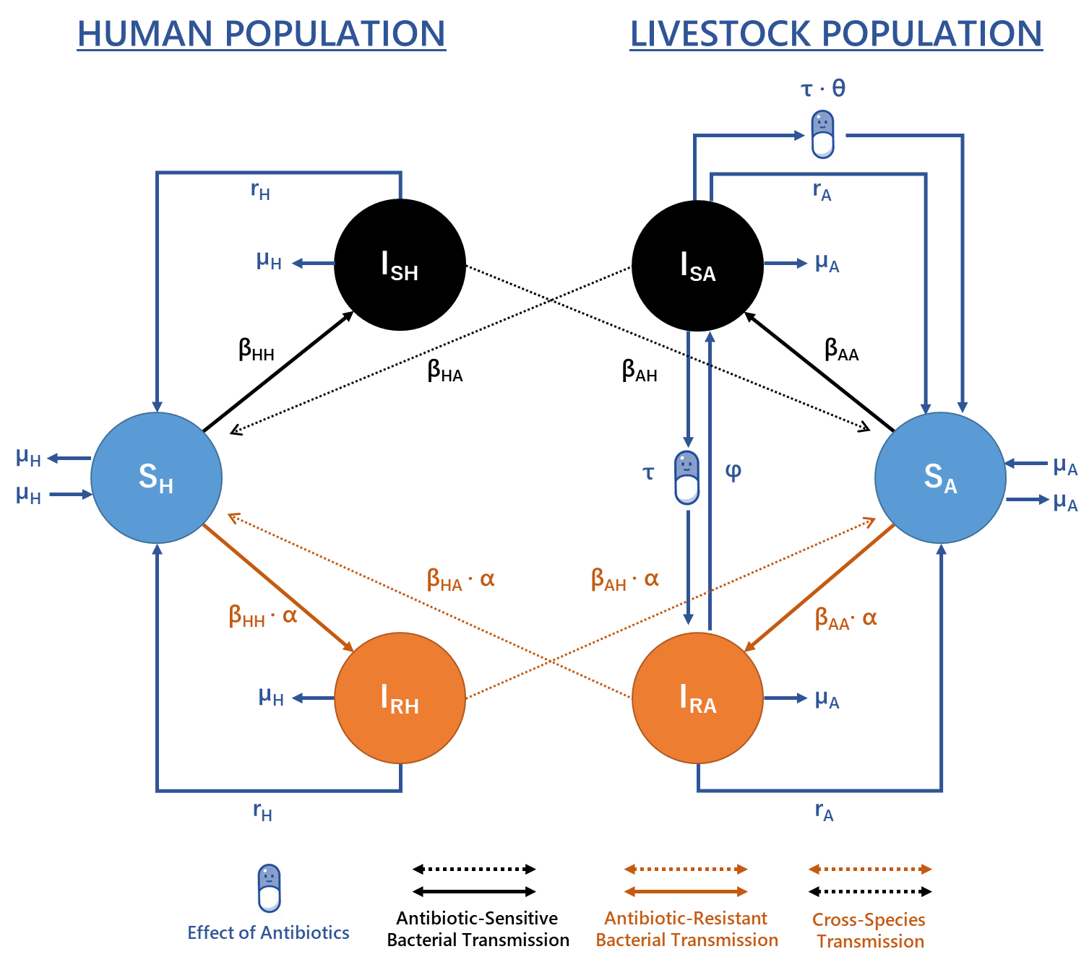
Parameter | Description
β_{i,j} | Per capita rate of direct/indirect transmission between infectious population j and susceptible population i.
τ | Per capita livestock antibiotic usage rate.
α | Relative fitness (transmission) of resistant strains relative to sensitive strains.
θ | Efficacy of antibiotic-mediated recovery.
φ | Antibiotic-resistant to antibiotic-sensitive reversion rate.
µ_{x} | Per capita birth/death rate in population x.
r_{x} | Per capita rate of recovery in population x.
Notes:
This model gives us a bunch of useful outcome measures
Overall Level of Human Foodborne Disease
Overall Level of Livestock Carriage
Proportion of Resistant Human Disease
Proportion of resistant Livestock carriage

Slide 3
Feedback from Initial Manuscript Draft
Case Study Alteration and Parameterisation
Introduce a specific antibiotic-resistance case study
Introduce alternative Campylobacter spp. case study
Move away from “hand parameterisation” in the model methods
Additional Model Analysis
What scenarios/parameters will cause the greatest increase in human foodborne disease upon livestock antibiotic curtailment?
Can we formalise exploration of parameters which best mitigate increases in human foodborne disease upon livestock antibiotic curtailment?
What is the updated story of the manuscript?
Remove worst case scenario mentions
Reframe the “story” of the manuscript

Slide 4
Case Study Alteration and Parameterisation
Introduce a specific antibiotic-resistance case study
Introduce alternative Campylobacter spp. case study
Move away from “hand parameterisation” in the model methods

Slide 5
Case Study Alteration and Parameterisation
Approximate Bayesian computation can be used for parameterisation
Data Available (for both tetracycline and ampicillin)
EFSA – Tetracycline-resistant Salmonella spp. in fattening pigs (and humans) across 21 countries in the EU
ESVAC – Livestock antibiotic sales data for EU countries.
FIT - Relationship between livestock antibiotic usage and the proportion of antibiotic-resistant livestock carriage.
Tetracycline and ampicillin-resistance are useful as case studies
Only antibiotic-resistance(s) found at an appreciable level in livestock and human populations.
Good level of antibiotic usage/sales in livestock populations
Not the most clinically relevant antibiotic-resistances - (compared to FQ and 3rd Gen cephalopsorins)

Slide 6
Tetracycline-resistant Salmonella spp. in Fattening Pigs
Only countries with n > 5 isolates in the EFSA data set were chosen (N = 18 countries)
Average current tetracycline usage for the 18 countries is 0.032 g/PCU
All outcome measures were calculated as EU-averages for the 18 fitted countries
What are the relevant outcome measures from this case study?
I_{CombH} at τ = 0.032: 3.262 per 100,000 (± 10%)
ResPropA at τ = 0.032: 0.409 (± 10%)
ResPropH at τ = 0.032: 0.32 (± 10%)
3.262 per 100,000 population for the overall level of human foodborne disease was calculated from Burden of Communicable Disease in Europe (BCoDE) estimates for the “actual” yearly community-level incidence in Europe.

Slide 7
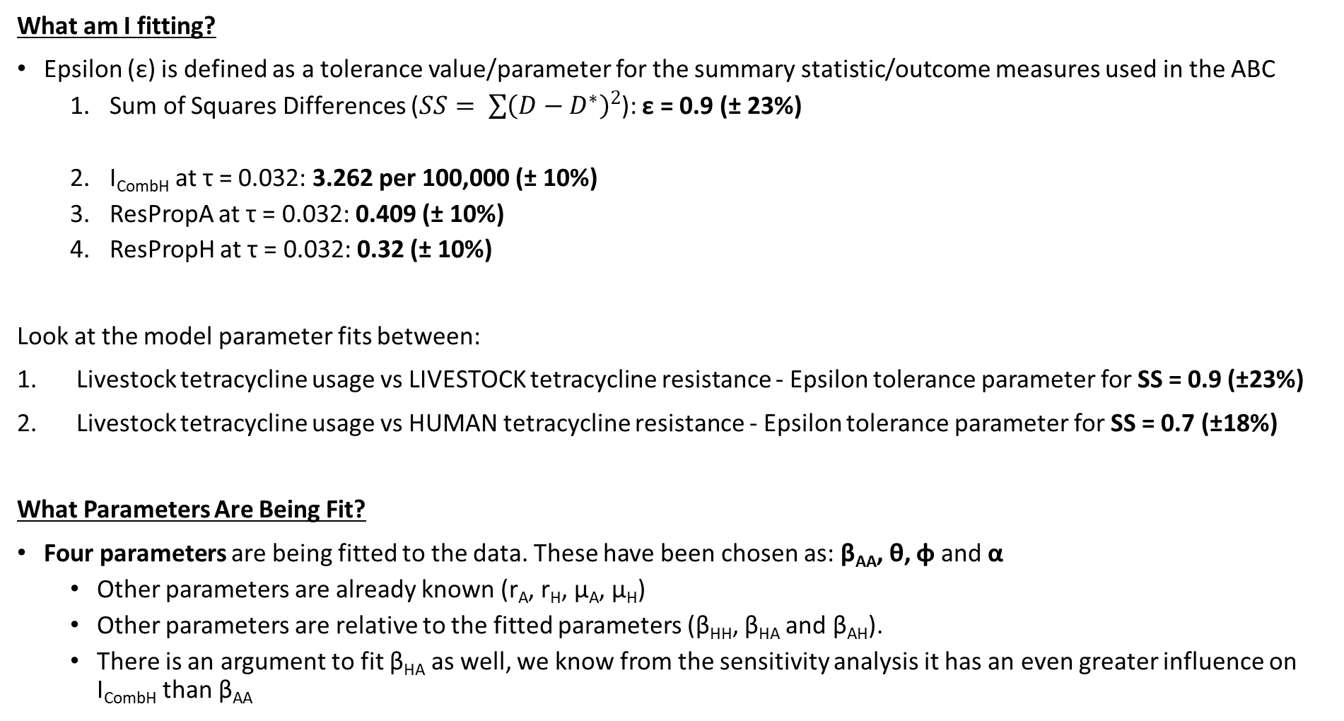
What am I fitting?
Epsilon (ε) is defined as a tolerance value/parameter for the summary statistic/outcome measures used in the ABC
Sum of Squares Differences ($SS= \sum{{\left(D−D^{∗}\right)}^{2}}$): ε = 0.9 (± 23%)
I_{CombH} at τ = 0.032: 3.262 per 100,000 (± 10%)
ResPropA at τ = 0.032: 0.409 (± 10%)
ResPropH at τ = 0.032: 0.32 (± 10%)
Look at the model parameter fits between:
Livestock tetracycline usage vs LIVESTOCK tetracycline resistance - Epsilon tolerance parameter for SS = 0.9 (±23%)
Livestock tetracycline usage vs HUMAN tetracycline resistance - Epsilon tolerance parameter for SS = 0.7 (±18%)
What Parameters Are Being Fit?
Four parameters are being fitted to the data. These have been chosen as: β_{AA}, θ, φ and α
Other parameters are already known (r_{A}, r_{H}, μ_{A}, μ_{H})
Other parameters are relative to the fitted parameters (β_{HH}, β_{HA} and β_{AH}).
There is an argument to fit β_{HA} as well, we know from the sensitivity analysis it has an even greater influence on I_{CombH} than β_{AA}
Notes:
Why I did not choose the standard deviations as the tolerance
Could only identify standard deviations for 2 of the 3 alternative outcome measures
ResPropA (N = 18) = 0.409 (1 SD; ± 0.212)
ResPropH (N = 18) = 0.32 (1 SD; ± 0.0986)
ICombH given as single point estimate (3.262 per 100,000 population)

Slide 8
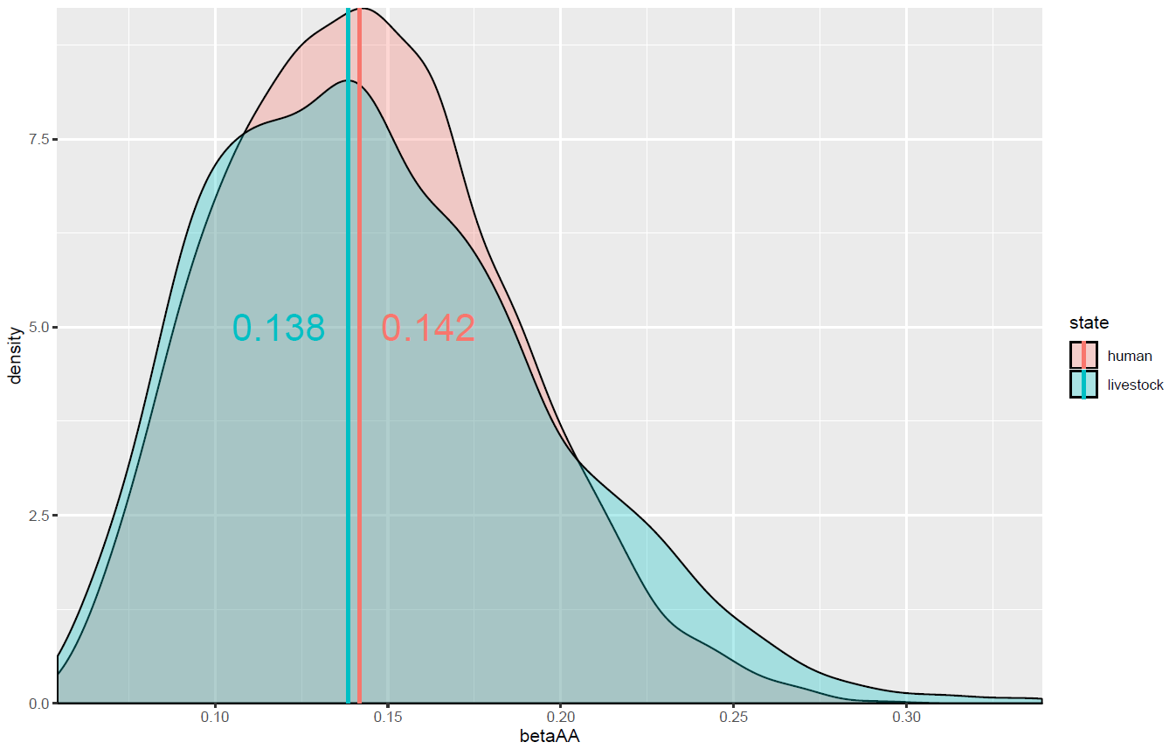
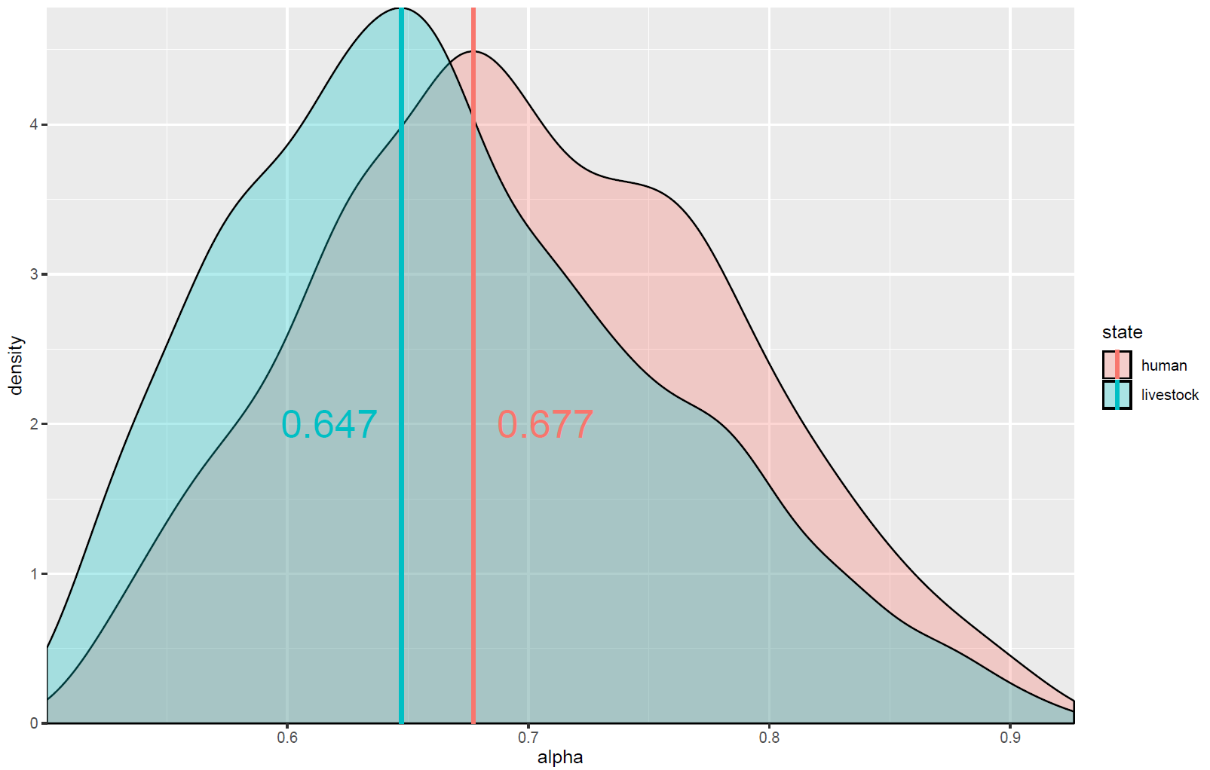
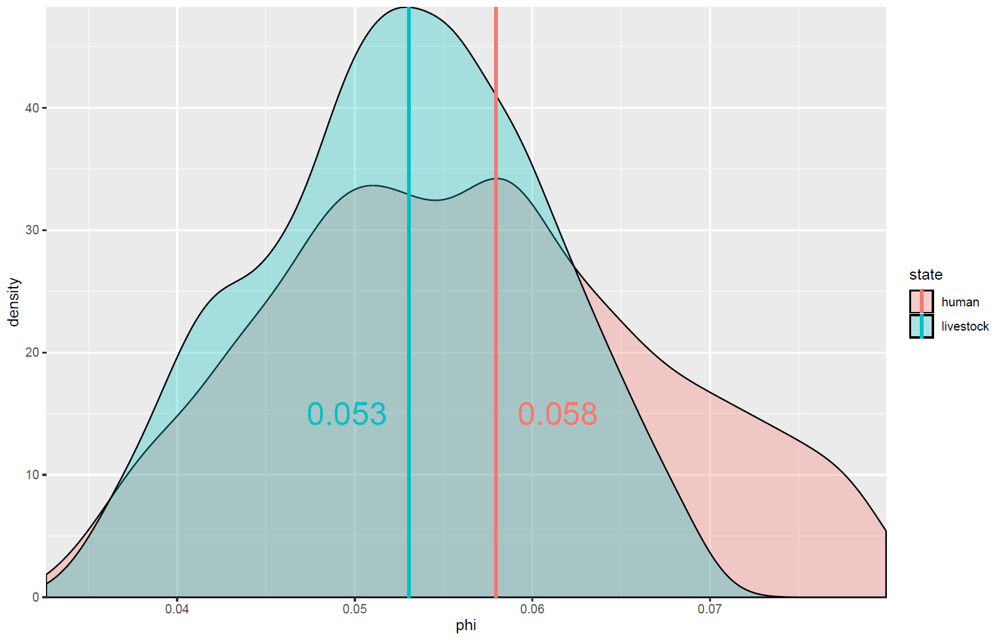
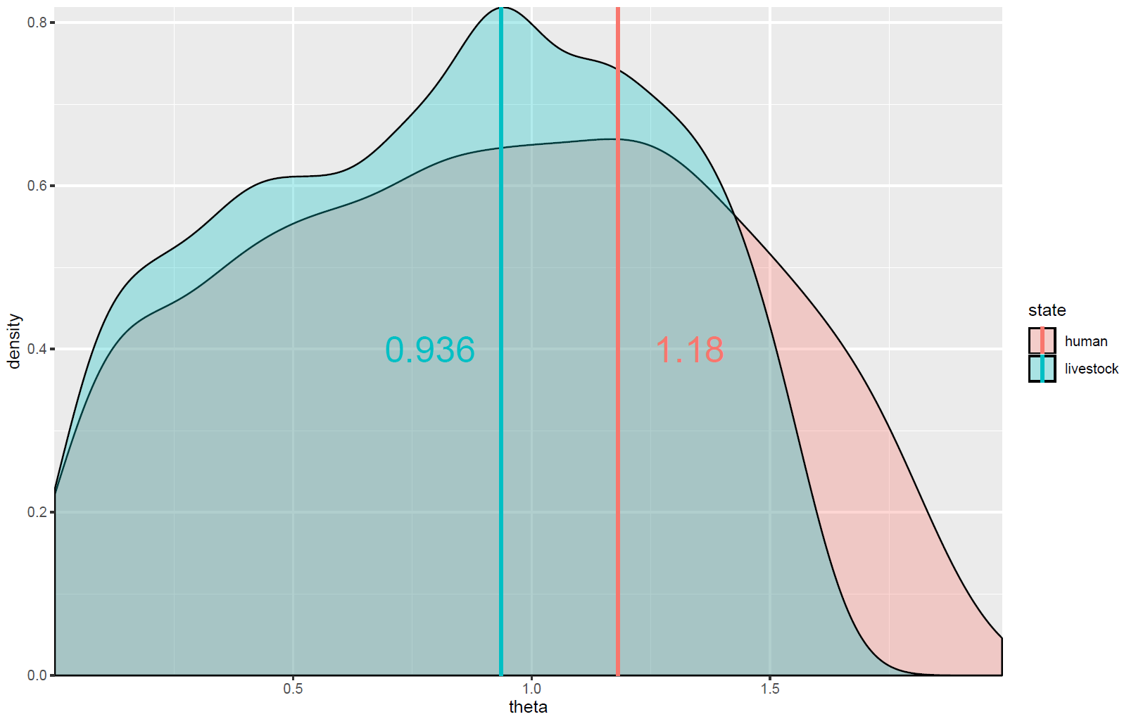
β_{AA} – Animal-to-animal transmission rate
α – Transmission fitness cost of resistance
φ – Reversion rate from I_{RA} to _{ISA}
θ – Efficacy of antibiotic-mediated recovery
Notes:
Explain the low alpha value for the model – limitations of the model
The fact that both model fits give fairly robust parameter values within the same ranges shows that you can successfully estimate parameters for the half of the model you are not fitting for within a fairly accurate level – the parameters from the method are robust – I think the data is ok enough.

Slide 9
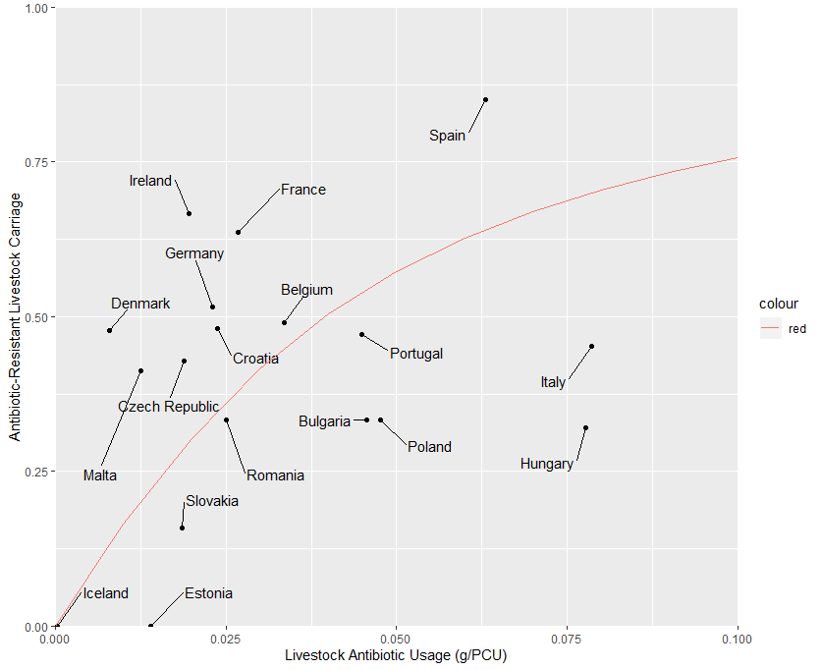
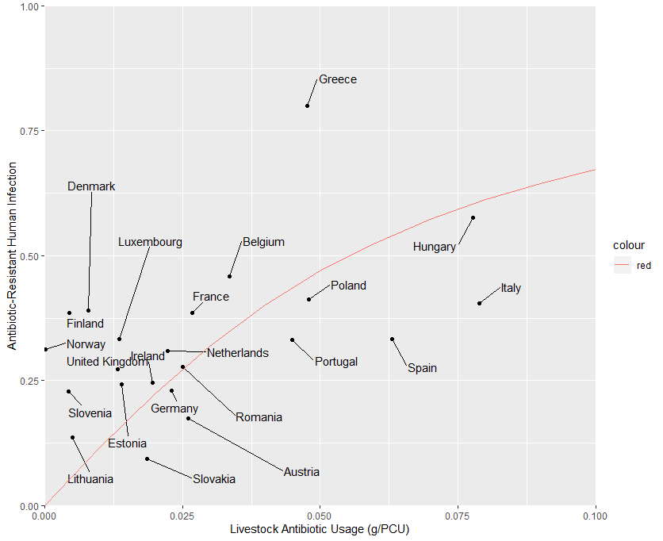
Model Fit | β_{AA} | β_{HH} | β_{HA} | β_{AH} | φ | α | θ | r_{A} | r_{H} | µ_{A} | µ_{H}
Livestock Usage vs Livestock Resistance | 0.138 | 0.00001 | 0.00001 | 0.00001 | 0.053 | 0.647 | 0.936 | 60⁻¹ days | 5.5⁻¹ days | 240⁻¹ days | 28835⁻¹ days
Tau vs Livestock Tetracycline Resistance (Livestock EFSA data)
Tau vs Human Tetracycline Resistance (Human EFSA data)
N = 18
N = 22

Slide 10
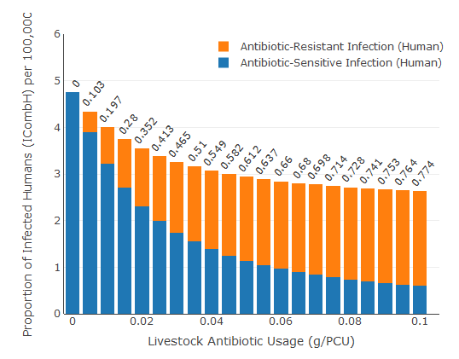
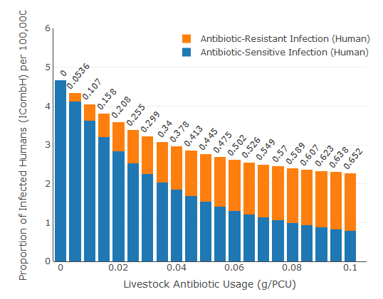
Model Fit | β_{AA} | β_{HH} | β_{HA} | β_{AH} | φ | α | θ | r_{A} | r_{H} | µ_{A} | µ_{H}
ABC Model Fit | 0.138 | 0.00001 | 0.00001 | 0.00001 | 0.053 | 0.647 | 0.936 | 60⁻¹ days | 5.5⁻¹ days | 240⁻¹ days | 28835⁻¹ days
Hand Parameterisation | 0.065 | 0.00001 | 0.00001 | 0.00001 | 0.04 | 0.9 | 0.7 | 60⁻¹ days | 7⁻¹ days | 240⁻¹ days | 28835⁻¹ days
Hand Parameterised
ABC Model Fit to Data
I_{CombH} at τ = 0.032: 3.21 per 100,000
ResPropA at τ = 0.032: 0.51
ResPropH at τ = 0.032: 0.48
I_{CombH} at τ = 0.032: 3.262 per 100,000
ResPropA at τ = 0.032: 0.409
ResPropH at τ = 0.032: 0.32

Slide 11
Campylobacter spp. in Dutch Broilers
Would be beneficial to have another case study - There is a lack of country-level resistance data – instead we could use a single country as a case study
No country-level data – can just fit to relevant outcome measures for the Netherlands (0.0198 g/pCU – ESVAC sales data)
I_{CombH} at τ = 0.0198: 4.799 per 100,000 (± 10%) (ECDC and BCoDE Estimates)
ResPropA at τ = 0.0198: 0.641 (± 10%) (MARAN Dutch Surveillance data)
ResPropH at τ = 0.0198: 0.452 (± 10%) (EFSA surveillance data )
EU-average for reported campylobacteriosis (2017) = 64.8 per 100,000 population/year
EU-average for estimated “community-level” campylobacteriosis (2010 – 2013) = 635.075 per 100,000 population/year
Scaling factor to obtain “true” community level prevalence = 9.8 times greater
Scaling factor applied (2017) to obtain the estimated level of community level campylobacteriosis in the Netherlands
32.5 per 100,000 population x 9.8 = 318.5 per 100,000 population/year or a point prevalence of 4.799 per 100,000
Notes:
DDDvet which is not comparable to my previous analysis
Point prevalence is actually the number of cases in a population of 100,000 individuals at a particular moment in time

Slide 12
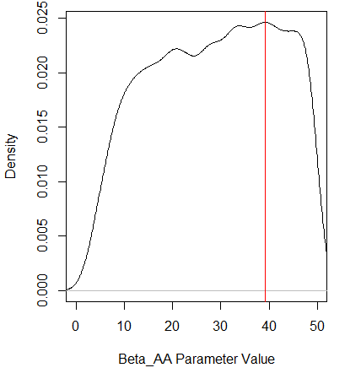
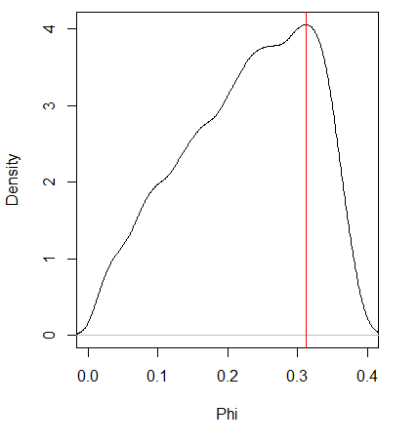
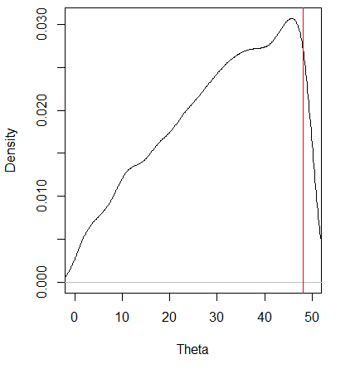
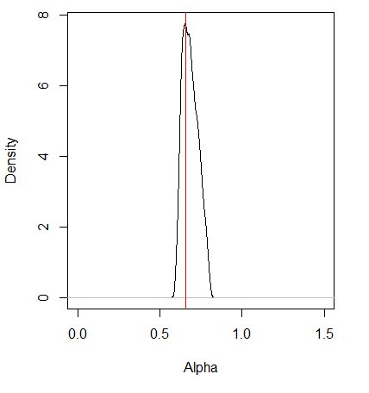
β_{AA}
φ
θ
α
MAP = 39.17
MAP = 0.32
MAP = 47.37
MAP = 0.66
Posterior distributions are not great after (n = 10000 particles). Likely due to:
Uninformative priors (uniform distribution)
Have lost key model fitting step (no country-level resistance data) – so the parameters are less restrained
Difference between human and livestock resistance is even greater than in Salmonella
What mechanism can drive the decrease in AMR seen between livestock and humans?
Functional limitation of alpha parameter? – Add Human resistance dynamics?
What transmission or human population dynamics would remove resistance I_{RH} -> I_{SH}?

Slide 13
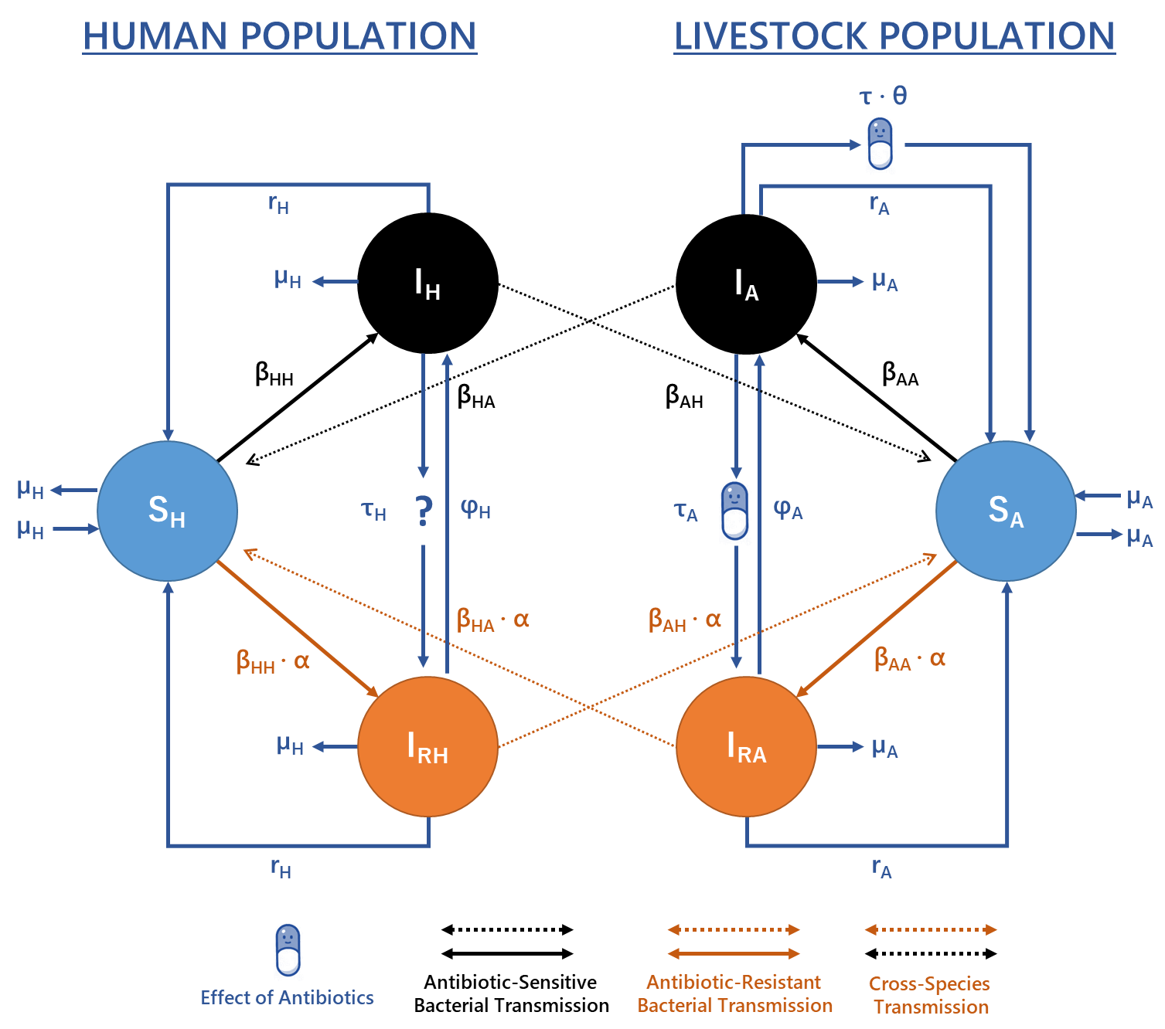
Parameter | Description
β_{i,j} | Per capita rate of direct/indirect transmission between infectious population j and susceptible population i.
τ | Per capita livestock antibiotic usage rate.
α | Relative fitness (transmission) of resistant strains relative to sensitive strains.
θ | Efficacy of antibiotic-mediated recovery.
φ | Antibiotic-resistant to antibiotic-sensitive reversion rate.
µ_{x} | Per capita birth/death rate in population x.
r_{x} | Per capita rate of recovery in population x.
Notes:
This model gives us a bunch of useful outcome measures
Overall Level of Human Foodborne Disease
Overall Level of Livestock Carriage
Proportion of Resistant Human Disease
Proportion of resistant Livestock carriage

Slide 14
2. Additional Model Analysis
What scenarios/parameters will cause the greatest increase in human foodborne disease upon livestock antibiotic curtailment?
Can we formalise exploration of parameters which best mitigate increases in human foodborne disease upon livestock antibiotic curtailment?

Slide 15
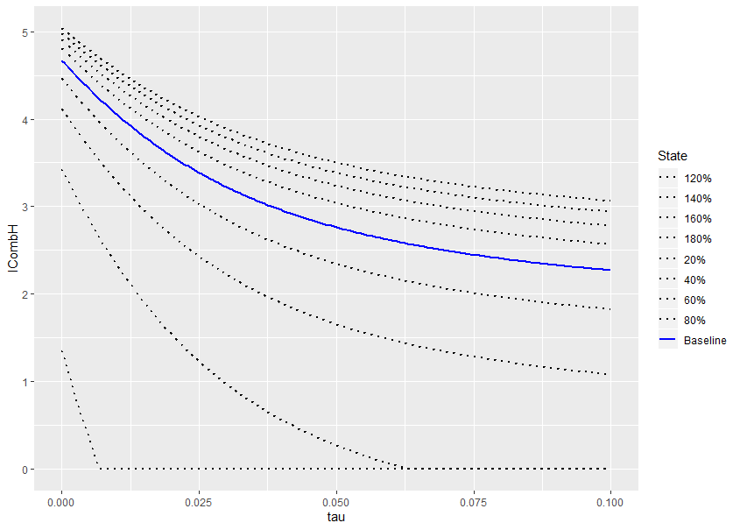
It is important to consider two concepts:
What are the parameters that could potentially result in the greatest increase in ICombH from baseline levels? – What determines the shape of the initial curve?
Once your baseline curve and parameters are set - what parameters can most effectively mitigate the increase in foodborne disease when livestock antibiotics are totally curtailed in your specific scenario?
What is the relative increase in ICombH upon livestock antibiotic curtailment compared to pre-curtailment levels? across different scenarios/parameters?
Each explored scenario will have a specific ICombH at curtailment (τ = 0) and at baseline ICombH (τ = 0.032)
2) Once a specific case study has been chosen, what parameters can reduce ICombH back below the baseline levels.
For the fitted parameter set/scenario as an example, baseline ICombH is static at 3.262 per 100,000.
What parameters can reduce ICombH back to this level?
Baseline Parameters: ICombH – 3.262 at
τ = 0.032

Slide 16
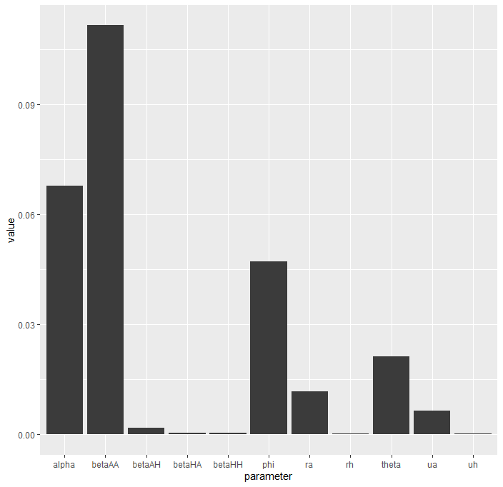
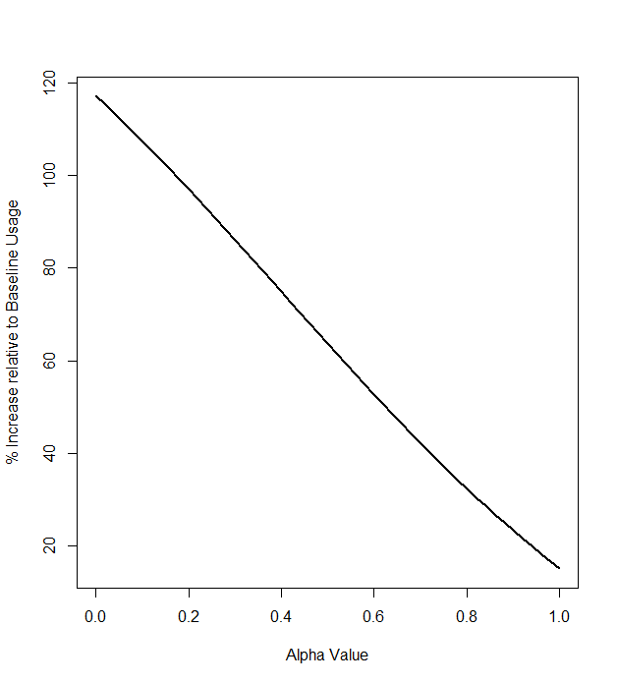
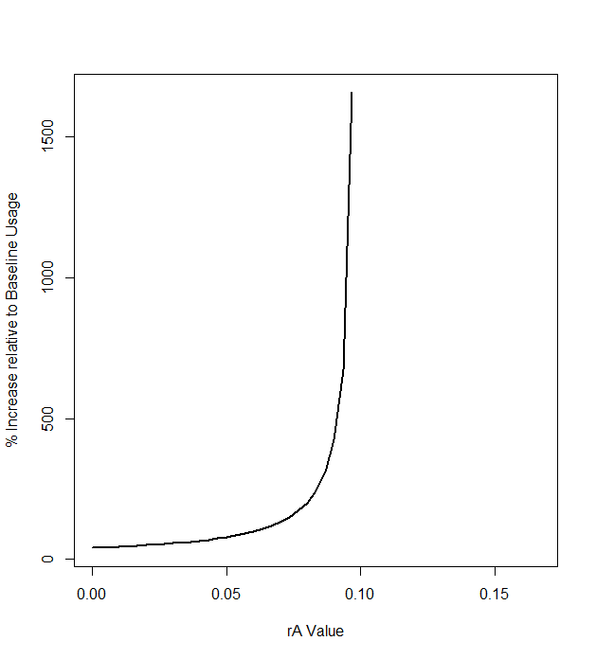
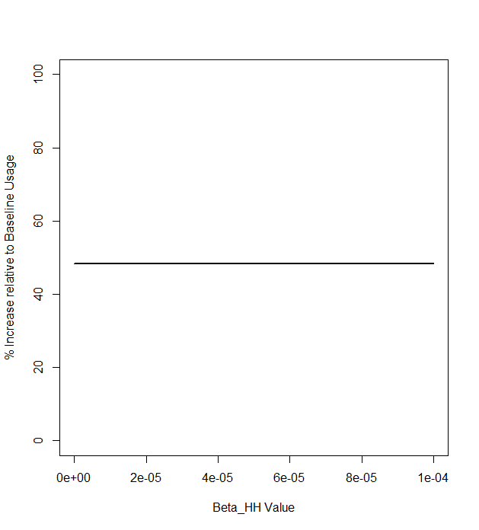
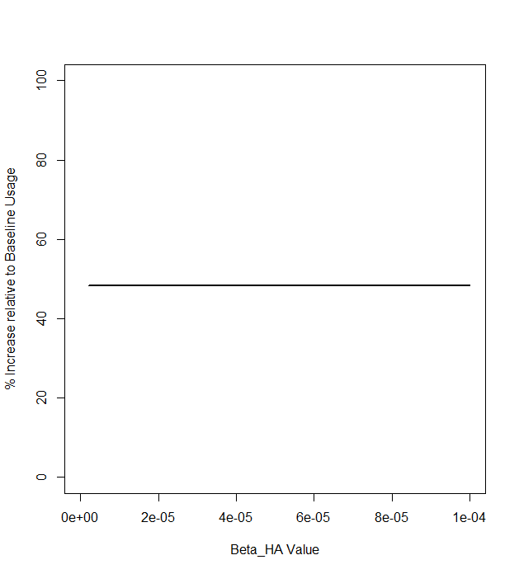
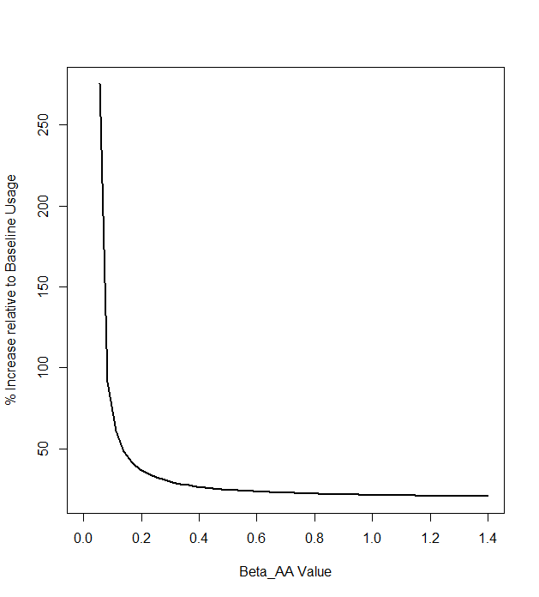
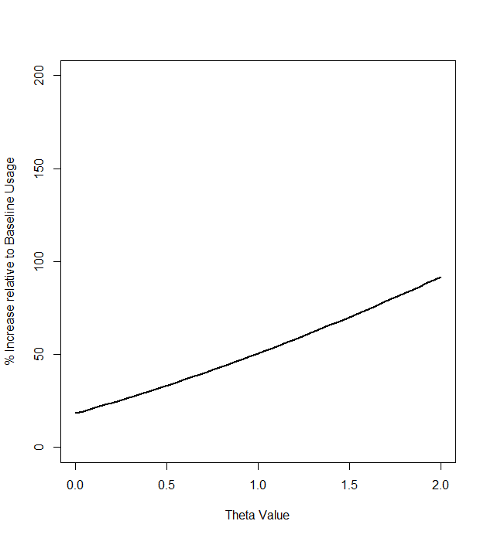

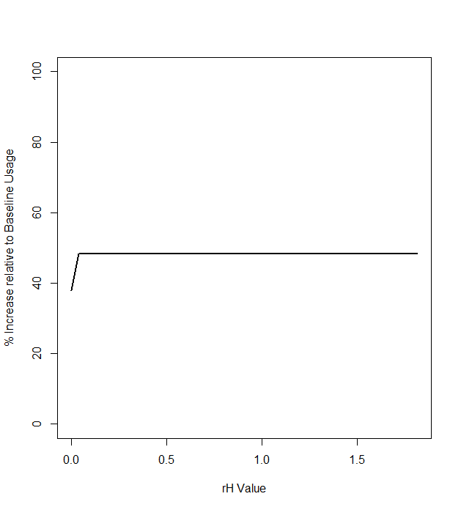
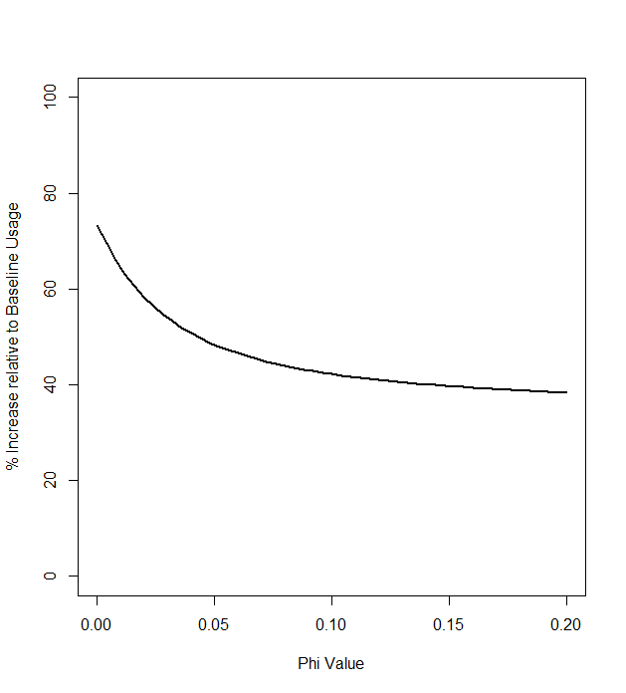
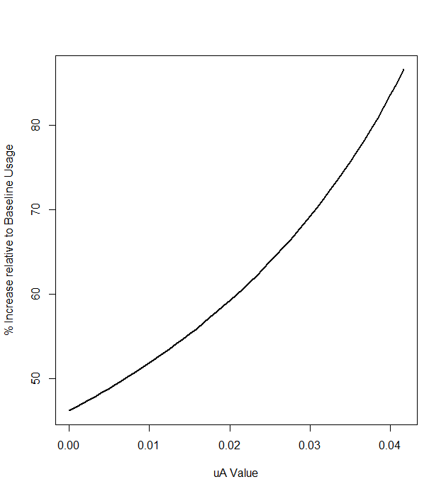
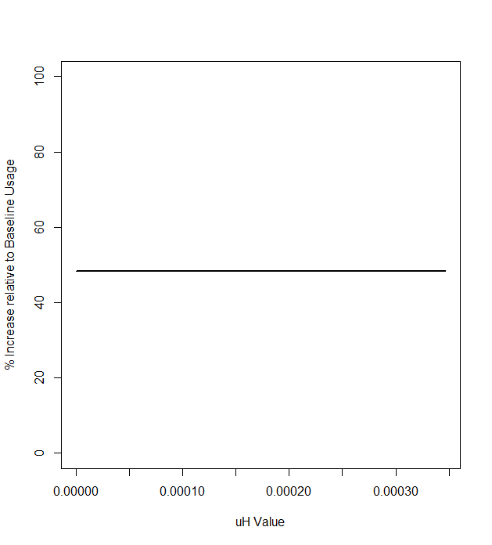
Alpha
rA
BetaHH
BetaHA
BetaAA
Theta
BetaAH
rH
RELATIVE % INCREASE IN ICOMBH UPON CURTAILMENT
Phi
µA
µH
Notes:
; umudarc@gmail.com

Slide 17
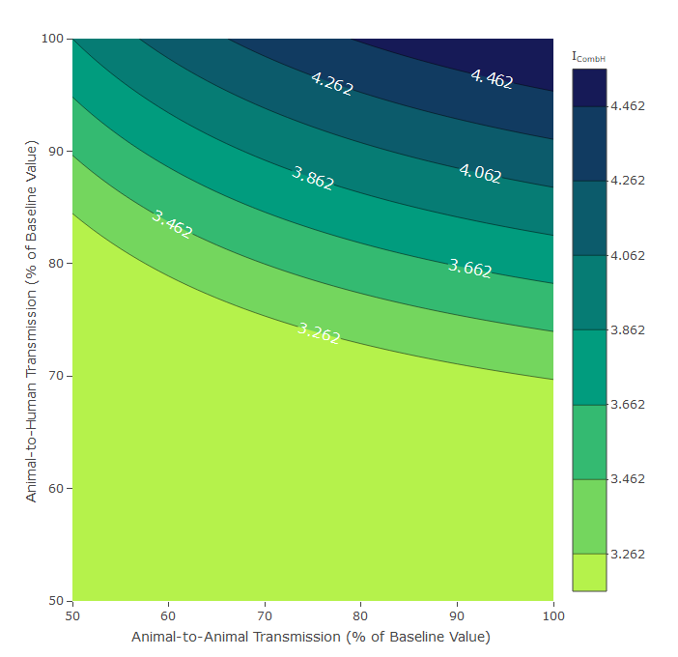
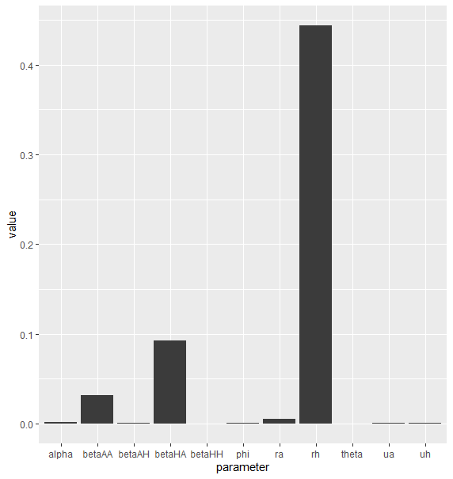
What parameters have the greatest effect at mitigating increases in human foodborne disease?
Sensitivity Analysis
ICombH at Curtailment
Notes:
They are not comparable outcome measures – but they help explain some phenomena
In a scenario with low β_{AA} you might observe greater increases in ICombH following livestock antibiotic curtailment (from that particular baseline usage level).
This means that the amount of ICombH you have to reduce to return back towards this baseline ICombH level is quite high and requires more “effort”
This effort takes the form of β_{AA} and β_{HA} reductions – which according to the sensitivity analysis – is the best way to return ANY ICombH back below the baseline levels
So you can have a parameter which can lead to greater increases in ICombH, but can also reduce ICombH quite well
Semi related to the original sensitivity analysis which looks at what parameters affect the overall levels of human foodborne disease (these three parameters and tau were very influential)

Slide 18
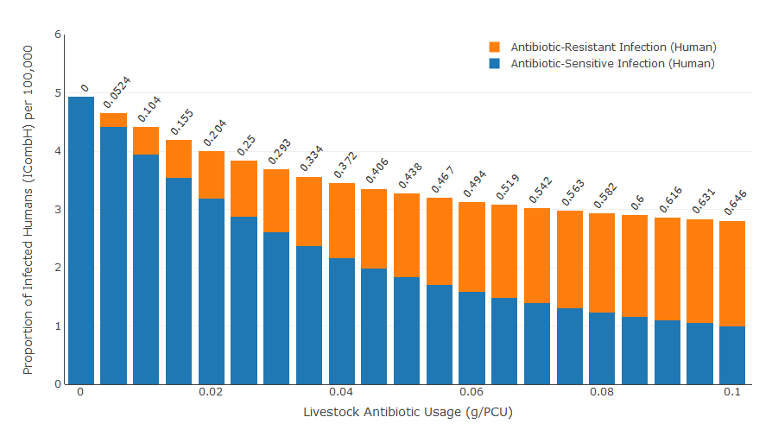
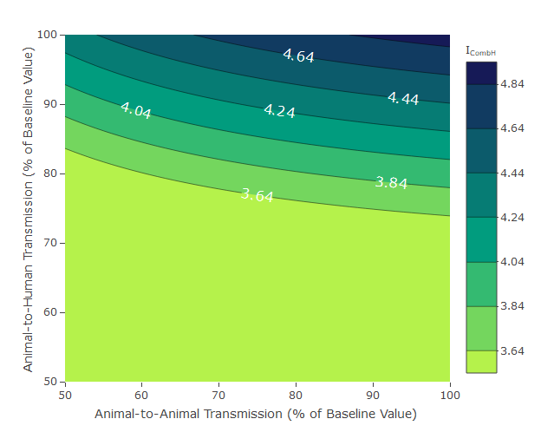
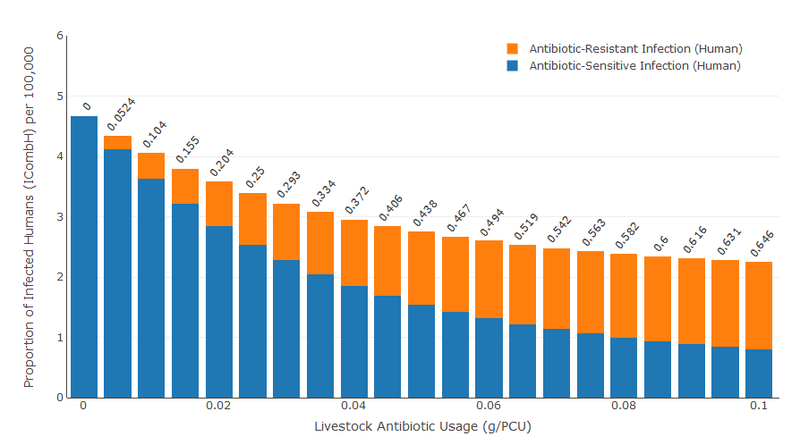
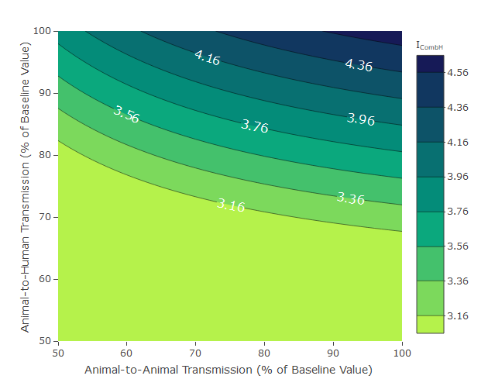
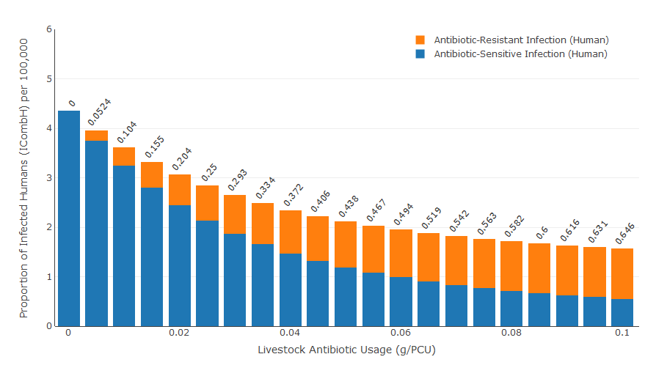
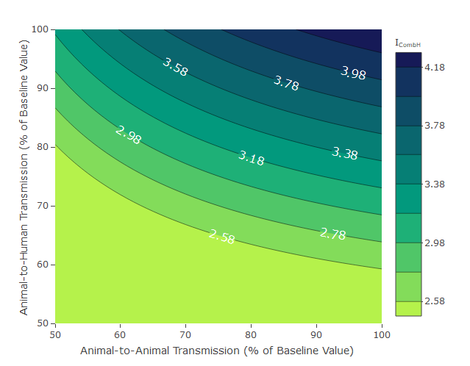
Curtailment (τ = 0) = 4.93 per 100,000
Baseline (τ = 0.032) = 3.64 per 100,000
Higher β_{AA} (0.2):
Lower relative increase in ICombH
Curtailment (τ = 0) = 4.67 per 100,000
Baseline (τ = 0.032) = 3.16 per 100,000
Baseline β_{AA} (0.138)
Lower β_{AA} (0.1):
Higher relative increase in ICombH
Curtailment (τ = 0) = 4.35 per 100,000
Baseline (τ = 0.032) = 2.58 per 100,000
Notes:
The lower the relative increase, the harder it is to bring back down to baseline right?

Slide 19
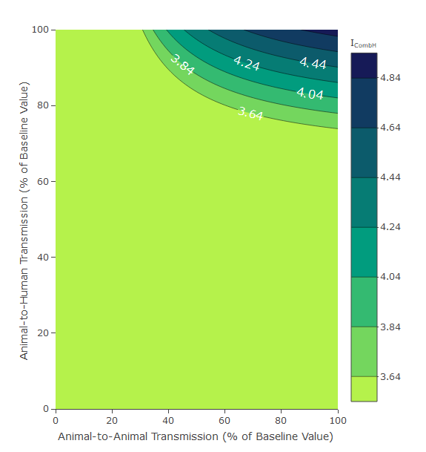
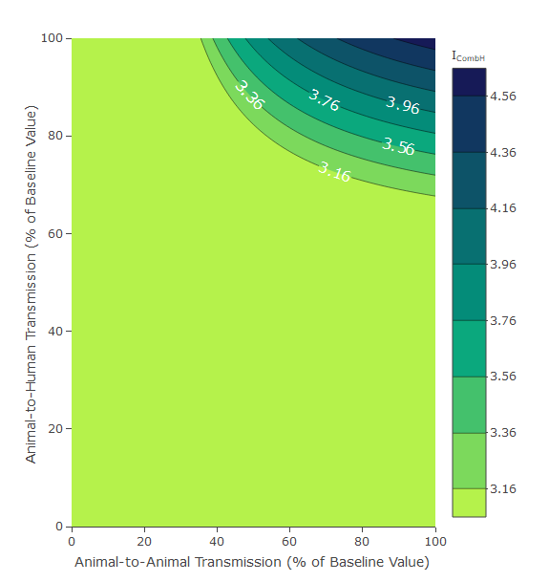
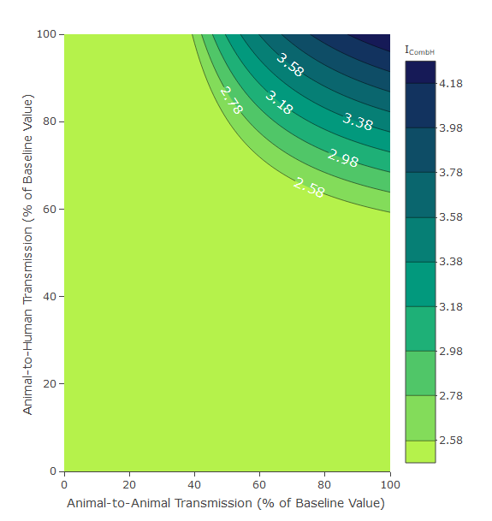
Lower β_{AA} (0.1):
Higher relative increase in ICombH
Higher β_{AA} (0.2):
Lower relative increase in ICombH
Baseline β_{AA} (0.138)
Critical Contours
Required Reduction to ICombH = ↓ 1.29 per 100,000
β_{HA} (↓ 26%) = 0.0000074
β_{AA} (↓ 69%) = 0.062 (not as effective)
Critical Contours
Required Reduction to ICombH = ↓ 1.51 per 100,000
β_{HA} (↓ 33%) = 0.0000067
β_{AA} (↓ 65%) = 0.0483 (not as effective)
Critical Contours
Required Reduction to ICombH = ↓ 1.77 per 100,000
β_{HA} (↓ 41%) = 0.0000059
β_{AA} (↓ 61%) = 0.039 (not as effective)
Notes:
Probably because betaAA is already so low

Slide 20
3. What is the updated story of the manuscript?
Remove worst case scenario mentions
Reframe the “story” of the manuscript

Slide 21
What is the updated story of the manuscript?
Case Study Alteration and Parameterisation
We have introduced a new tetracycline-resistant Salmonella in fattening pigs case study
We have introduced an ABC fitting approach
We have introduced an alternative Campylobacter spp. case study
Additional Model Analysis
We have identified certain parameters/scenarios which may cause a greater increase in foodborne disease upon curtailment.
We have formalised the exploration of β_{AA} and β_{HA} parameters as parameters which can best mitigate increases in ICombH, under the baseline scenario.

Slide 22
Take Home message of Manuscript - Updated
We have created a simple population-based AMR transmission model – with the assumption that livestock antibiotic usage drives livestock resistance and can be used to treat (and clear) livestock carriage of antibiotic-sensitive food-borne bacteria.
We observe increases in human foodborne disease upon livestock antibiotic curtailment
Hopefully across multiple drug bug combinations – Ampicillin and campylobacter case studies
Certain parameters/scenarios are key to driving greater increases in overall human foodborne disease upon curtailment
The greatest increase in overall human foodborne disease occurs when β_{AA} is lower, α is low, φ is low and μ_{A} and r_{A} are low.
β_{HA} and to a lesser extent β_{AA} reductions can be used as agricultural biosecurity interventions to drive the overall level of human foodborne disease back towards baseline levels

Slide 23
SUPP FIGURES

Slide 24
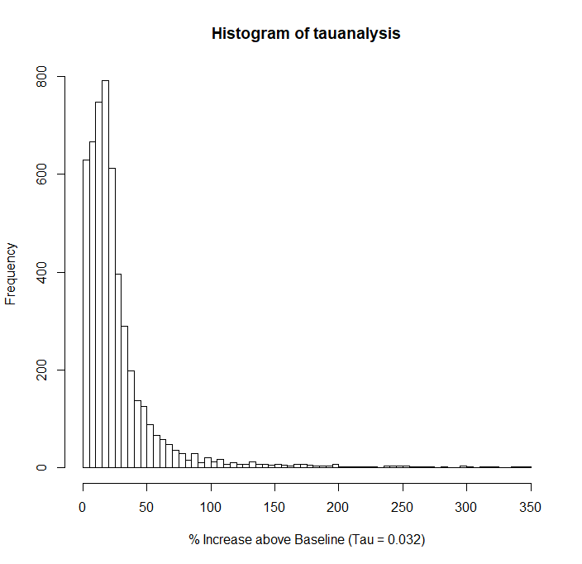
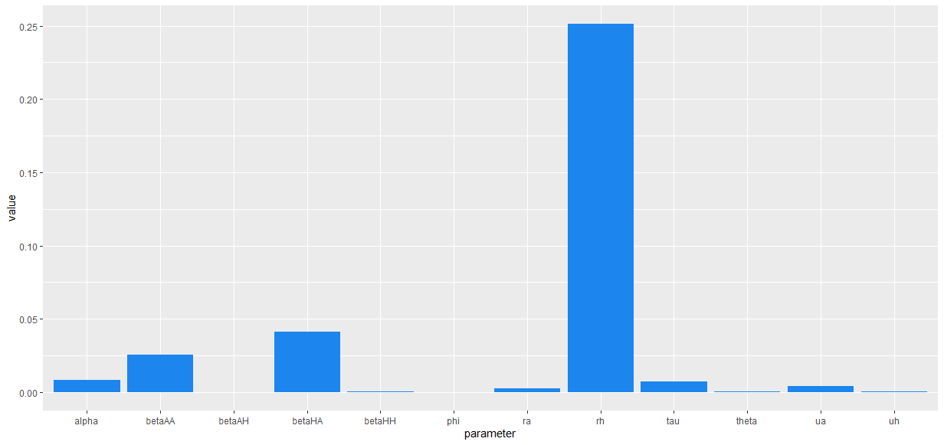
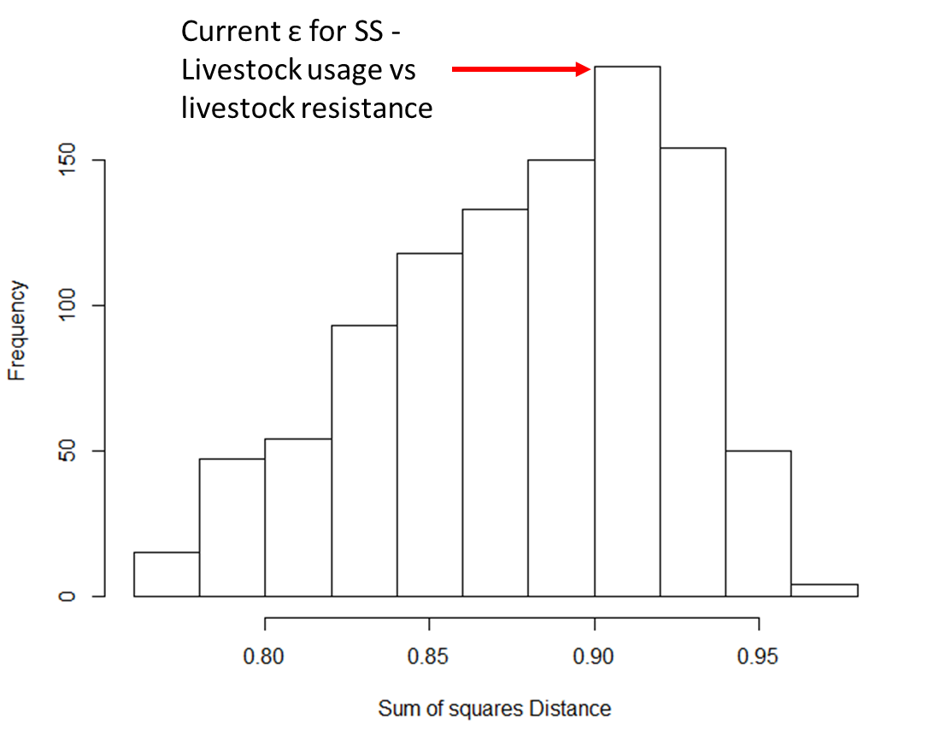
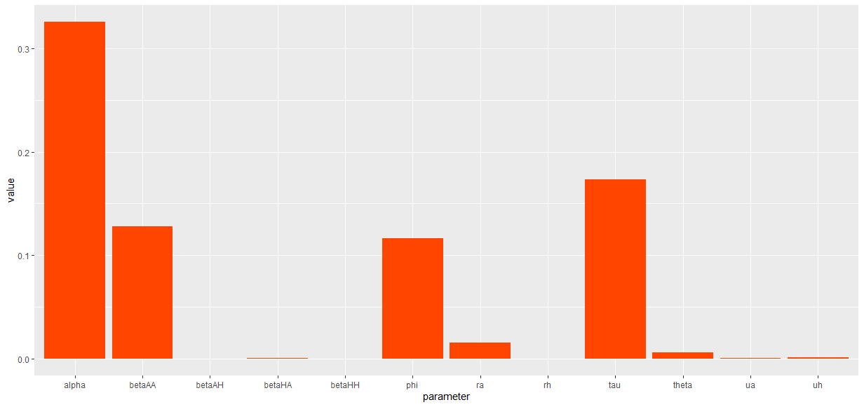
Sensitivity Analysis
Overall Level of Human Foodborne Disease
Proportion of Resistant Human Foodborne Disease

Slide 25
ABC Model Fitting
Sample θ* from the prior distribution of each parameter.
Simulate the model using parameter set θ*, to obtain simulated data D*.
If the distance measure between the simulated data and the observed data (D) is less than or equal to the distance measure (d) tolerance threshold (ε): d(D,D*) ≤ ε; then accept the θ* parameter set (or particle)
Repeat until N particles have been accepted (N = 2500)
Calculate a maximum a posteriori (MAP) estimate from the posterior distribution of each parameter.

Slide 26
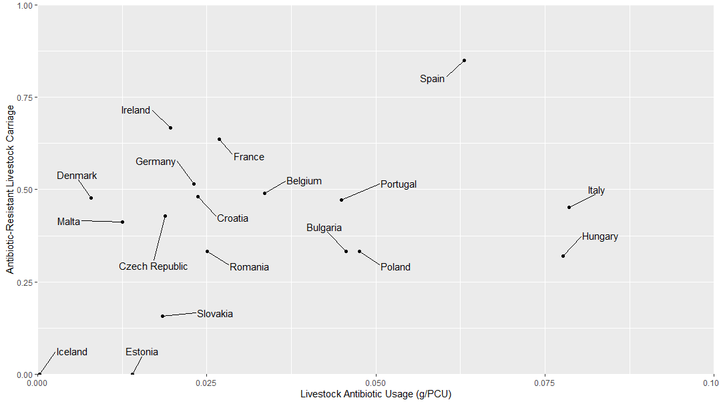
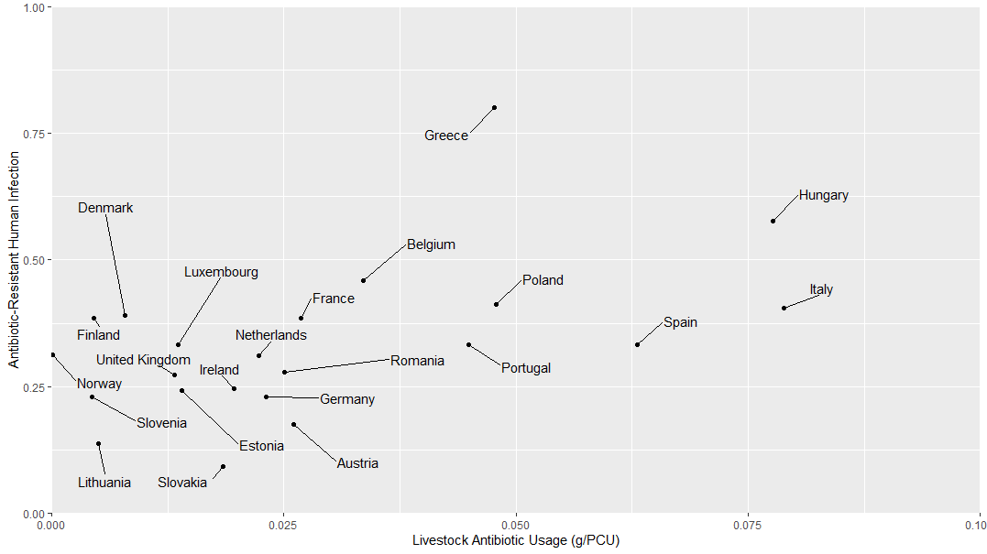
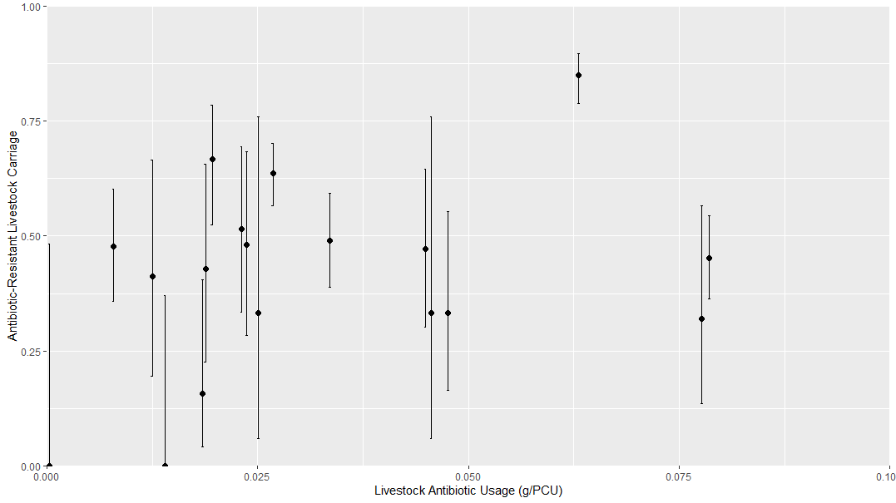
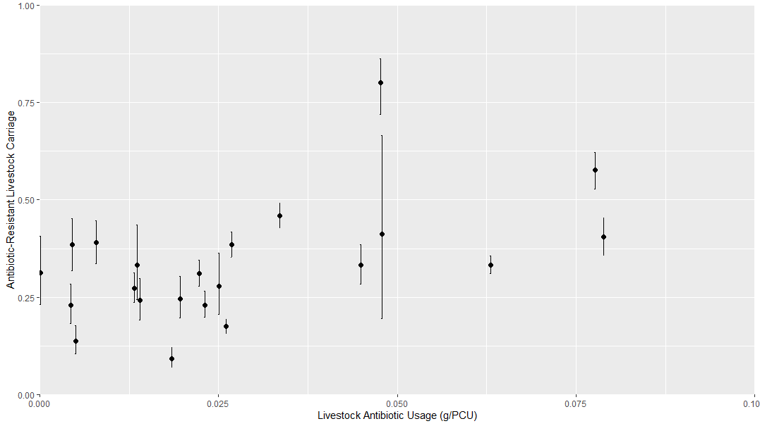
Livestock Tetracycline Usage vs Human Tetracycline Resistance (n =18)
Livestock Tetracycline Usage vs Human Tetracycline Resistance (n = 22)

Slide 27
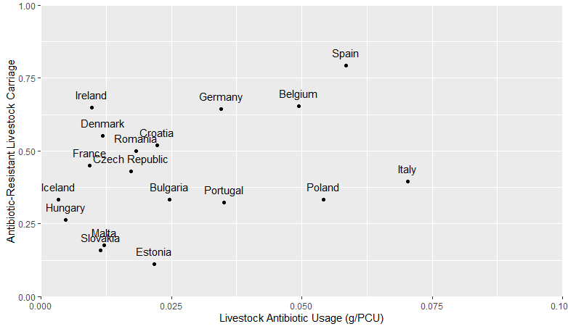
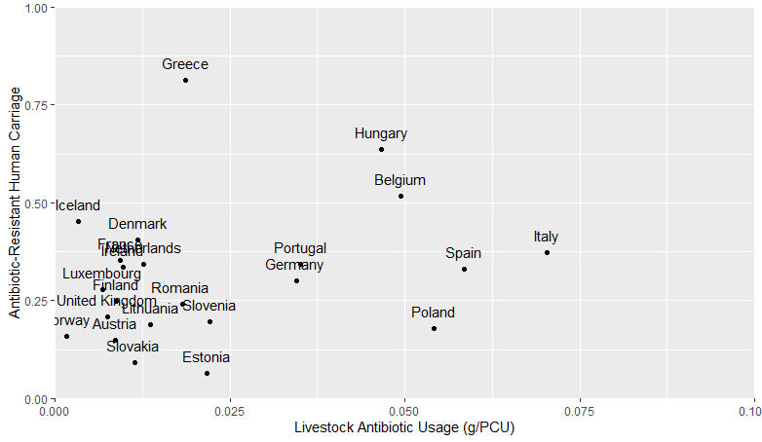
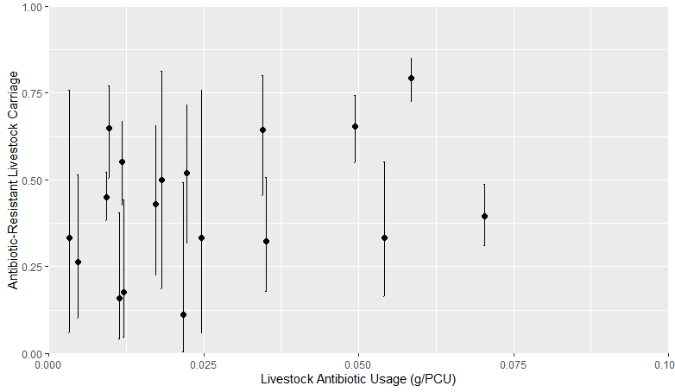
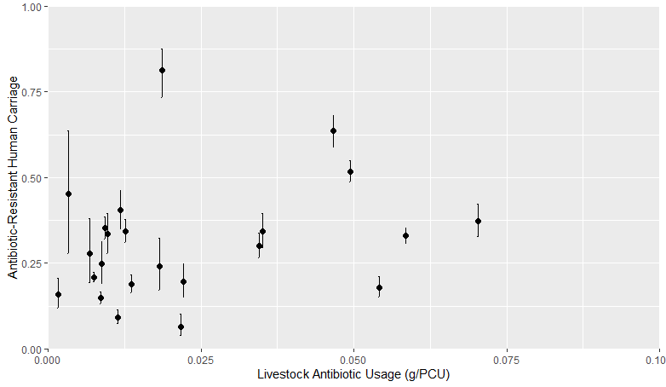
Livestock Ampicillin Usage vs Human Ampicillin Resistance (n = 18)
Livestock Ampicillin Usage vs Human Ampicillin Resistance (n = 23)
Notes:
One more since we have Iceland in the human analysis

Slide 28




Linear Regression comparing Livestock Tetracycline Usage vs Livestock/Human Tetracycline Resistance
Livestock Tetracycline Usage vs Livestock Tetracycline Resistance
Livestock Tetracycline Usage vs Human Tetracycline Resistance
RSME = 27.1
RSME = 19.8
RSME = 22.3
RSME = 17.9
Notes:
Root squared mean error = residual standard error – essentially on average how far the residuals are from the actual data for all of the countries
Linear regression might be better – but it is a very surface understanding of the surveillance results
There are some caveats to this – the linear regression does not incorporate any of the underlying disease AMR dynamics
Such as the relationship between the parameters and the overall level of infection and the proportion of antibiotic sensitive data

Slide 29
Fitted outcome measures:
Sum of Squares Differences: LIV vs LIV ε = 0.9 (± 22.3%) and LIV vs HUM ε = 0.7 (± 18.3%)
I_{CombH} at τ = 0.032: 3.262 per 100,000 (± 10%)
ResPropA at τ = 0.032: 0.409 (± 10%)
ResPropH at τ = 0.032: 0.32 (± 10%)
Also did a fit where I allowed β_{HA} to vary - so 5 parameters were varied
Model Fit | β_{AA} | β_{HH} | β_{HA} | β_{AH} | φ | α | θ | r_{A} | r_{H} | µ_{A} | µ_{H}
Livestock Usage vs Livestock Resistance | 0.138 | 0.00001 | 0.00001 | 0.00001 | 0.053 | 0.647 | 0.936 | 60⁻¹ days | 5.5⁻¹ days | 240⁻¹ days | 28835⁻¹ days
Livestock Usage vs Human Resistance | 0.142 | 0.00001 | 0.00001 | 0.00001 | 0.058 | 0.677 | 1.18 | 60⁻¹ days | 5.5⁻¹ days | 240⁻¹ days | 28835⁻¹ days
Livestock Usage vs Livestock Resistance (5 parameters) | 0.078 | 0.00001 | 0.00000768 | 0.00001 | 0.0525 | 0.678 | 0.899 | 60⁻¹ days | 5.5⁻¹ days | 240⁻¹ days | 28835⁻¹ days
Model Fitting | No. Parameters | Sum of Squares from model using MAP values (% Deviation) |  | ICombH | ResPropA | ResPropH
 |  | Livestock | Human | Livestock | Livestock | Livestock
Livestock Usage vs Livestock Resistance | 4 | 0.85 (22.3) | 0.67 (17.9) | 3.15 | 0.432 | 0.327
Livestock Usage vs Human Resistance | 4 | 0.87 (22.6) | 0.67 (17.9) | 3.15 | 0.432 | 0.327
Livestock Usage vs Livestock Resistance | 5 | 0.84 (22.2) | 0.65 (17.6) | 1.62?? | 0.42 | 0.33
Notes:
Similar fits here show that the parameterisation procedure is producing similar results – the model fits are comparable.

Slide 30











Alpha
rA
BetaHH
BetaHA
BetaAA
Theta
BetaAH
rH
Phi
µA
µH

Slide 31
Not for Publication – Additions to Thesis Chapter
This model contradicts a number of established AMR model structures that look at strain co-existence
Null-Neutral Models
Explicitly describe within-host dynamics
It would be interesting to add to this study in my thesis
Implement different co-existence models and fit to the data
See what the models say about the analysis I have conducted.

